Slide 1

School of Electrical Engineering and Computer Science
Department of Electrical Engineering
EE-371 : Control Systems
Lecture#19,20
6.1 Introduction
6.2 Routh-Hurwitz Criterion
Textbook: Chapter # 06 (5th edition)
Text Book: Control Systems Engineering by Norman S. Nise 5th Edition
Instructor: Ms Neelma Naz
Class: BEE 12 C/D

Slide 2
Stability
Textbook: Chapter # 06 (5th edition)
Text Book: Control Systems Engineering by Norman S. Nise 5th Edition
6.1 Introduction

Slide 3
Routh-Hurwitz Criterion
The Routh-Hurwitz criterion for stability is a method that yields stability information without the need to solve for the closed-loop system poles.
The criterion gives the number of roots with positive real parts, and does not give the exact value of the roots.
Therefore this stability criterion gives us the absolute stability analysis, determining if any poles are in the RHP or on the jw axis.
The method requires two steps:
(1) Generate a data table called a Routh table
(2) Interpret the Routh table to tell how many system poles are in the left half-plane, in the right half-plane, and on the jω-axis

Slide 4
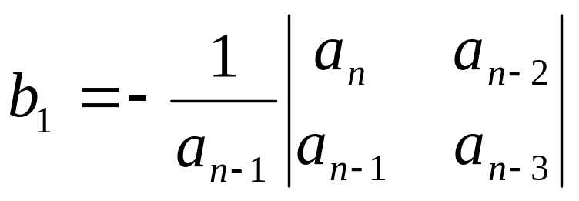

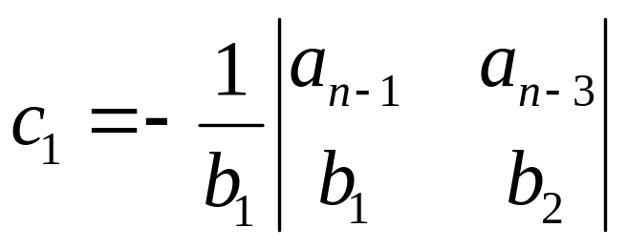
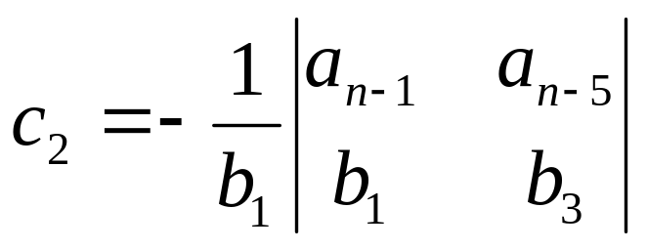
First step make the Routh Array:
s^{n} a_{n} a_{n-2} a_{n-4} a_{n-6} ……
s^{n-1} a_{n-1} a_{n-3} a_{n-5} a_{n-7} ……
s^{n-2} b₁ b₂ b₃ b₄ ……
s^{n-3} c₁ c₂ c₃ c₄ ……
. .
. .
. .
s² k₁ k₂
s¹ l₁
s⁰ m₁

Slide 5
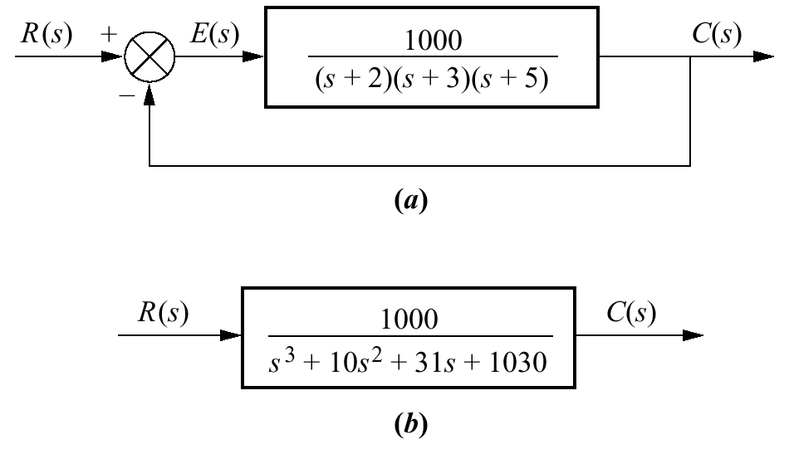
Example 6.1
Make the Routh table for the system shown in the Figure.
Feedback system
SOLUTION
Find the equivalent closed-loop system because we want to test the denominator of the closed-loop transfer function.
How the transfer function is found ???
Equivalent closed-loop system

Slide 6
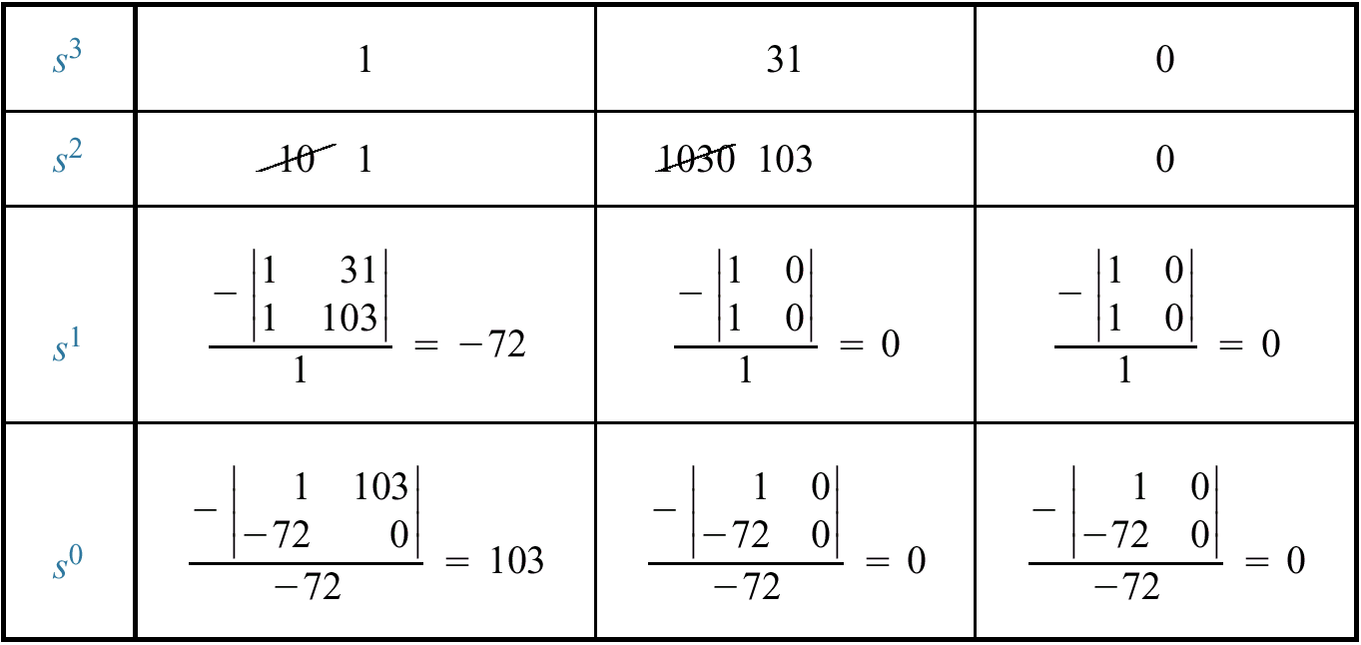
Make a Routh Table and label the rows with powers of s from s³ down to s⁰ in a vertical column
Form the first and second row using the coefficients of the Polynomial.
Elements of subsequent rows are computed from the entries of the preceding rows
Completed Routh table

Slide 7
s³ | 1 | 31 | 0
s² | 1 | 103 | 0
s¹ | -72 | 0 | 0
s⁰ | 103 | 0 | 0

Slide 8
Interpreting the Basic Routh Table
The basic Routh table applies to systems with poles in the left and right half-planes
The Routh-Hurwitz criterion declares that the number of roots of the polynomial that are in the right half-plane is equal to the number of sign changes in the first column of Routh Table.
s³ | 1 | 31 | 0
s² | 1 | 103 | 0
s¹ | -72 | 0 | 0
s⁰ | 103 | 0 | 0
How many sign changes in this Routh table ???

Slide 9
Class Activity 1
PROBLEM:
Make a Routh table and tell how many roots of the following polynomial are in the right half-plane and in the left half-plane.

Slide 10
Stable,
Unstable, and
Marginally Stable Systems
Examples:

Slide 11
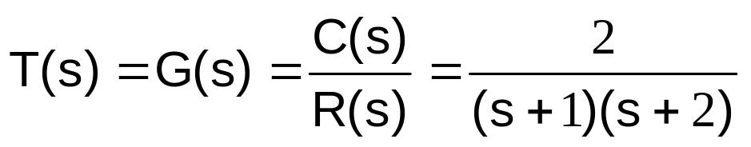
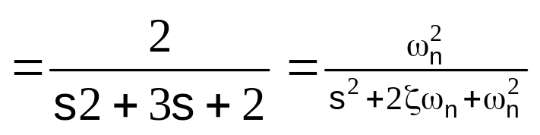
Example:1
Stability
Stable or Unstable?
S-plane
Characteristic equation (s+1)(s+2)=0
x
x
-2
-1
Hence s+1=0 or s=-1
and s+2=0 or s=-2
The natural-response terms for the system are k₁e^{-t} and k₂e^{-2t}

Slide 12
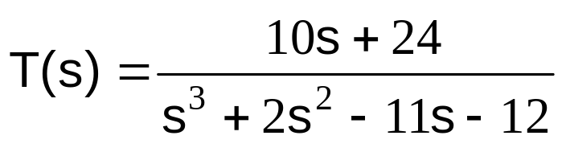
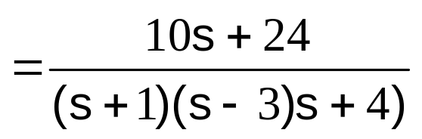
Example 2:
Hence roots are s= -1, s= 3, & s= -4
Stable or Unstable?
Unstable due to s=3
The natural-response terms for the system are k₁e^{-t} , k₂e^{3t}, and k₃e^{-4t}
Unstable due to term k₂e^{3t}
MATLAB Program:
x
x
x
-4
-2.4
-1
3
>> p = [1 2 -11 -12];
>> r = roots(p)
Note: Numerator 10s+24 has NO role in the stability of the system

Slide 13
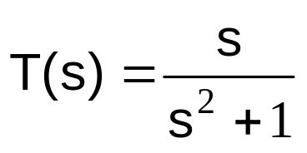
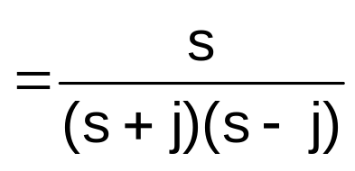
Example:3
Hence roots are s= -j, s= j
x
j
Stable or Unstable?
Marginally stable
x
-j
The natural-response terms for the system are ksin(t+θ)
Marginally stable because no exponential term
MATLAB Program:
>> p = [1 0 1];
>> r = roots(p)

Slide 14
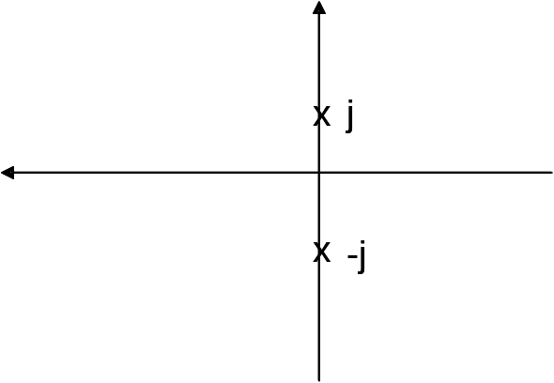
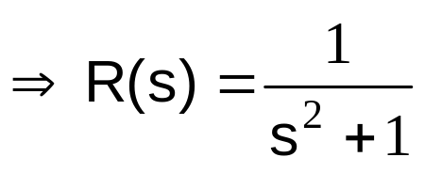
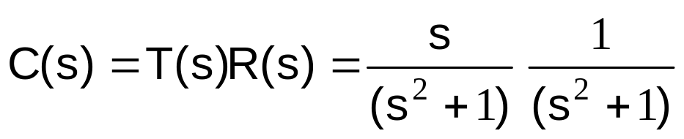
Example:4
Hence roots are s= -j, s=j
Marginally stable
Let the input r(t) = sint
The response of the system c(t) = t sint
Stable or Unstable?
Unstable due to t
sint is marginally stable but the multiplication of time (t) makes it unstable
NOTE: The natural-response of the system are ksin(t+θ) bounded (marginally stable) but produce unbounded output (unstable) for certain bounded input

Slide 15
Routh-Hurwitz Criterion: Special Cases
Zero Only in the First Column
Entire Row is Zero

Slide 16
Case 2
(Zero element in first column)
Un-stable system

Slide 17
Example1: (Case 2)
Q(s) = s⁵ + s⁴ + 2s³ + 3s² + s + 4
s⁵ 1 2 1
s⁴ 1 3 4
s³ -1 -3
s²
0

Slide 18
Case 2 (Steps)
1. First Element of a row is Zero (0)
2. Replace “0” by small number ε. (ε=0.00000000..01)
3. Continue the array

Slide 19
Example1: (Case 2)
Q(s) = s⁵ + s⁴ + 2s³ + 3s² + s + 4
s⁵ 1 2 1
s⁴ 1 3 4
s³ -1 -3
s² ε 4
s¹ (4-3 ε )/ε
s⁰ 4
0
RHP=2
LHP=3
IA = 0
Two sign changes whether ‘ε’ was
assumed +ve or –ve.
UNSTABLE SYSTEM

Slide 20
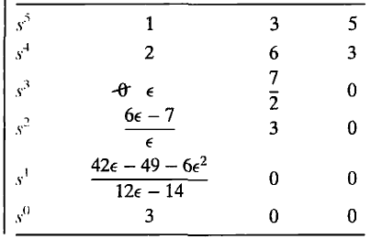
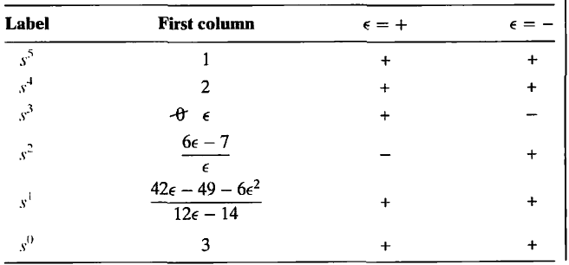
Class Activity 2
Q(s) = s⁵ + 2s⁴ + 3s³ + 6s² + 5s +3
Routh Table: Sign changes in first column
Two sign changes whether ‘ε’ was
assumed +ve or –ve.
UNSTABLE SYSTEM

Slide 21
Case 3
(All Element of a row are Zero
(Premature Termination )

Slide 22
Example: (Case: 3)
Case 3: (Steps)
1. All Element of a row are Zero. (Premature Termination )
2. Auxiliary Polynomial
3. Aux Poly is differentiated with respect to ‘s’
4. Coefficients of the Polynomial replaces the zero row
Ex. Q(s) = s² + 1
s² 1 1
s¹ 0
s⁰
Aux Pol = s² + 1
2
d/ds(s² + 1)
1
2s
No sign change in the first column
implies that system is STABLE.
Aux poly indicates roots on jw axis, which implies MARGINALLY STABLE
S²=-1; S=±j

Slide 23
What is Auxiliary Polynomial ??
s² 1 1
s¹ 0
s⁰
Q(s) contains an even polynomial as factor. An even polynomial is one in which the exponents of s are even integers or zero
This even polynomial is called “Auxiliary Polynomial”
In Routh array, coefficients of “Aux Poly” are those directly above the zero row.
Aux Pol = s² + 1
s³ 1 2
s² 1 2
s¹ 0
s⁰
Aux Pol = s² + 2

Slide 24
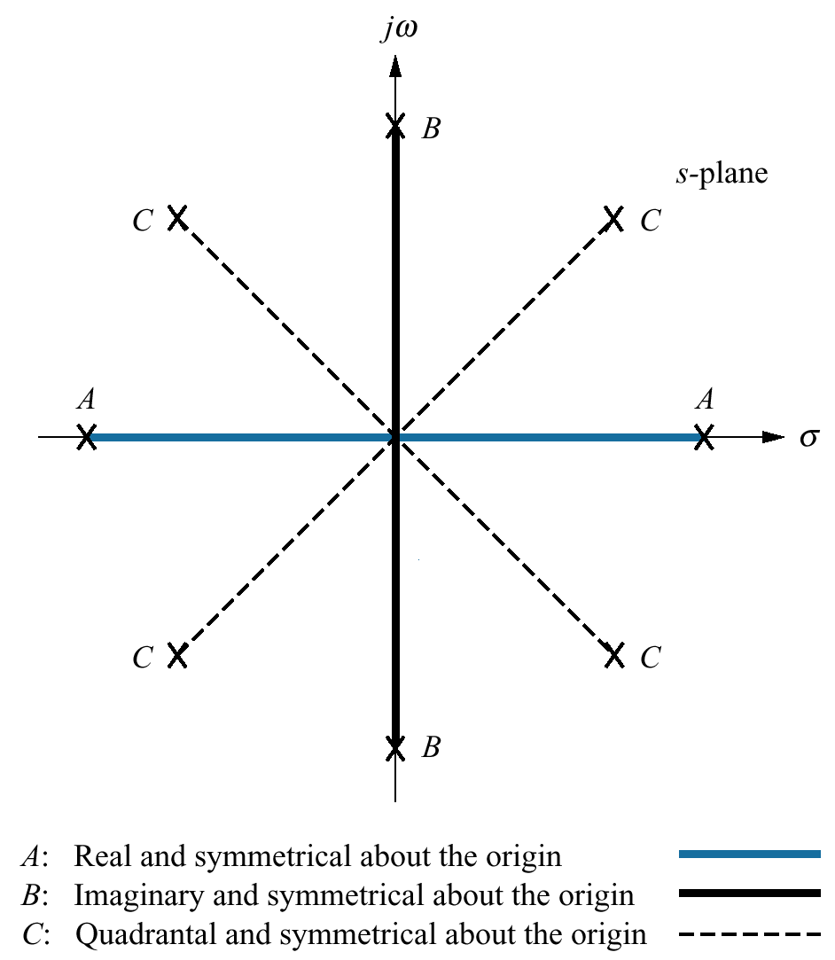
Even polynomials only have roots that are symmetrical about the origin.
This symmetry can occur under three conditions of root position:
(1) The roots are symmetrical and real
(2) The roots are symmetrical and imaginary
(3) The roots are quadrantal

Slide 25
Example: (Case: 3)
Case 3: (Steps)
1. All Element of a row are Zero. (Premature Termination )
2. Auxiliary Polynomial
3. Aux Poly is differentiated with respect to ‘s’
4. Coefficients of the Polynomial replaces the zero row
Ex. Q(s) = (s+1) (s² + 2) = s³ + s² + 2s + 2
S³ 1 2
s² 1 2
s¹ 0
s⁰
Aux Pol = s² + 2
d/ds(s² + 2)
2s
2
RHP=0
LHP=1
IA = 2
2

Slide 26
Example: (Case: 3)
Ex. Q(s) = s⁴ + s³ + 3s² + 2s + 2
S⁴ 1 3 2
S³ 1 2
s² 1 2
s¹ 0
s⁰
Aux Pol = s² + 2
d/ds(s² + 2)
2s
2
RHP=0
LHP=2
IA = 2
2

Slide 27
Class Activity 3
s⁶ + s⁵ + 5s⁴ + s³ + 2s² - 2s – 8
S⁶ 1 5 2 -8
S⁵ 1 1 -2
S⁴ 4 4 -8
S³ 0 0
s² 2 -8
s¹ 72
s⁰ -8
Aux Pol = 4s⁴ +4s² - 8
16
8
d/ds(4s⁴ +4s² - 8)
16s³ +8s
RHP=1
LHP=3
IA =2

Slide 28
Class Activity 4
P(s) = S⁴ + 2s³ + 4s² + 2s + K
S⁴ 1 4 K
S³ 2 2
S² 3 K
S¹ (6-2K)/3
→ (6-2K)/3 > 0
Stable
S⁰ K
→ K> 0
Stable
Stability range 0 < K < 3
For what value of K the system will be marginally stable?

Slide 29
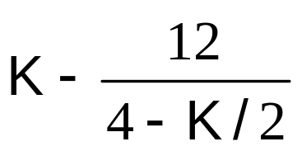
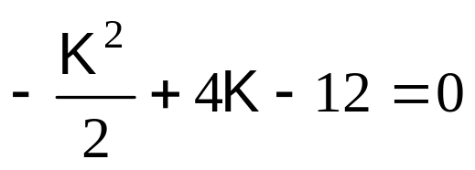
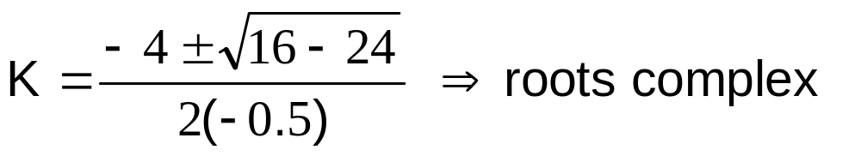
Example
P(s) = S⁴ + 2s³ + 4s² + Ks + 6
S⁴ 1 4 6
S³ 2 K
S² 4-K/2 6
→ K < 8
Stable
S¹
→ > 0
Stable
S⁰ 6
Stability range can not be satisfied for any value of K (complex roots). Polynomial has RHP roots for all K

Slide 30
Quick Excercise
Q(s) = s⁵ +2s⁴ + 8s³ + 11s² + 16s + 12

Slide 31
Example_Case_3
Q(s) = s⁵ +2s⁴ + 8s³ + 11s² + 16s + 12
s⁵ 1 8 16
s⁴ 2 11 12
s³ 2.5 10
s² 3 12
s¹ 0
s⁰ 12
Aux Pol = 3s² + 12
d/ds(3s² + 12)
6s
No sign change in the first column MARGINALLY STABLE.
Aux poly indicates roots on jw axis
3s² = -12 s² = -4 s_{1,2}=±j2
6

Slide 32

???

